Slide 1

DATA SCIENCE PROJECT
Clustering Based on
K-Means
> Unlocking Musical "Vibes" with Machine Learning
MODEL
APPLICATION
K-Means Algorithm
Song Recommendation

Slide 2
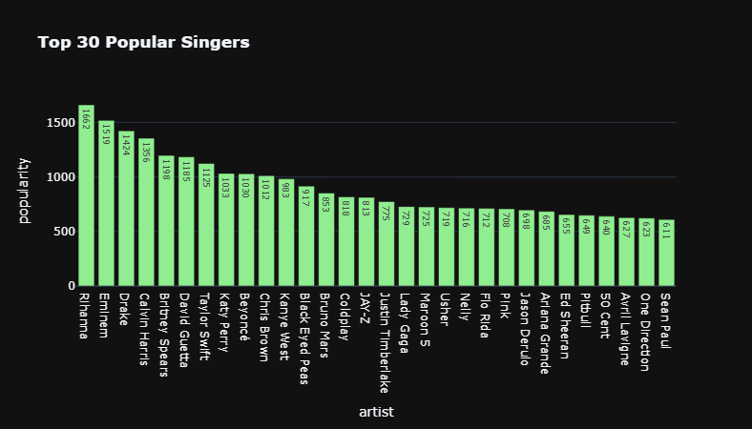
Exploratory Data Analysis

Slide 3
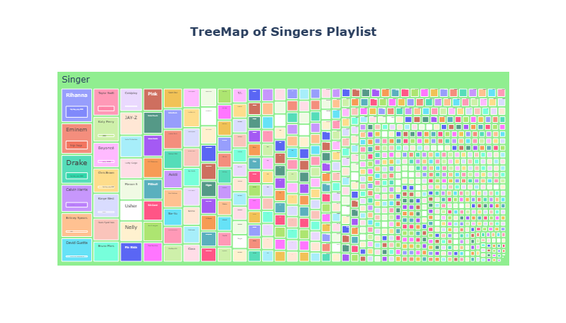
Exploratory Data Analysis

Slide 4
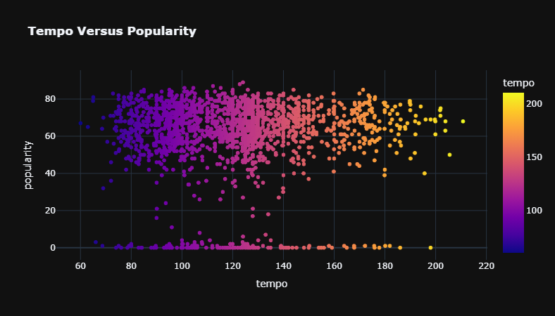
Exploratory Data Analysis

Slide 5
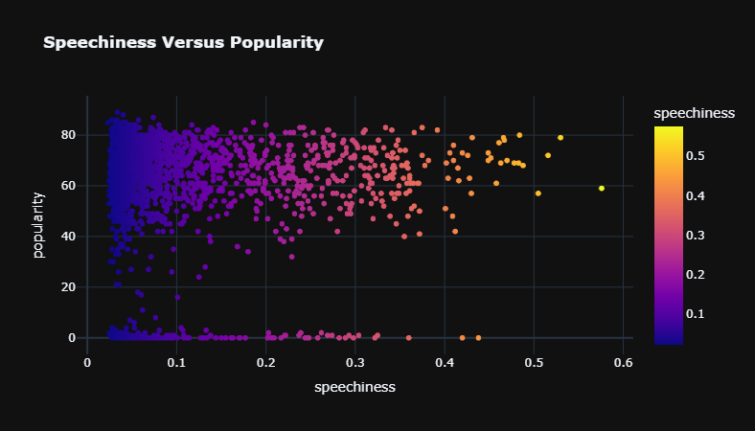
Exploratory Data Analysis

Slide 6
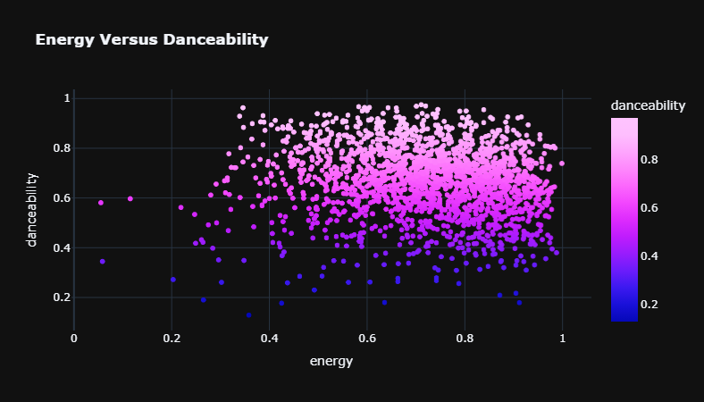
Exploratory Data Analysis

Slide 7

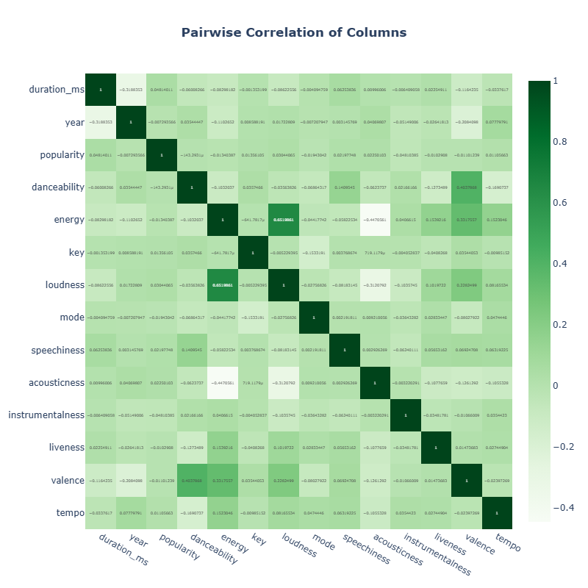






2.1 Feature Selection for the "Vibe" Model 02
We selected high-dimensional audio features to capture the "feel" of a track. The heatmap reveals correlations between features (e.g., Energy vs. Loudness).

Slide 8

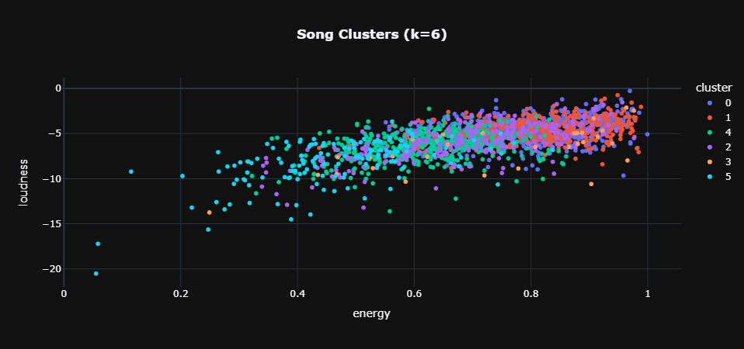
2.2 Clustering Analysis (K-Means)
Methodology
•
Applied K-Means on normalized feature vectors.
•
Determined K=6 as the optimal number of clusters based on Elbow Method.
Insight
The visualization shows distinct groupings, where each color represents a unique musical "vibe" or genre profile.

Slide 9
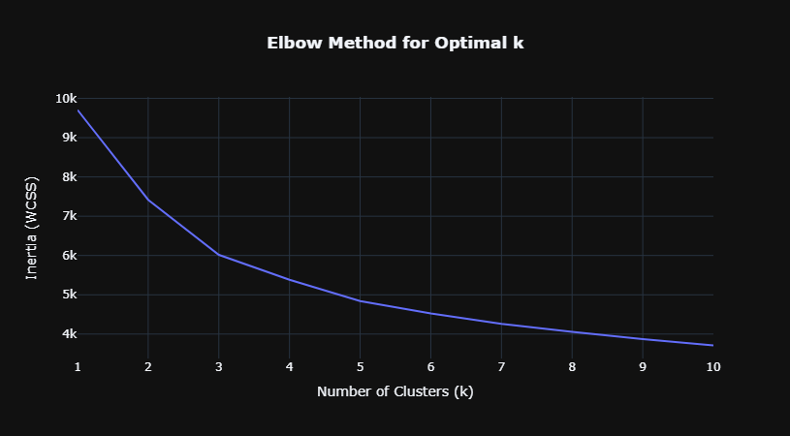
Elbow Method To Determine Optimal K

Slide 10
6 Clustering Based on K-Means

Slide 11
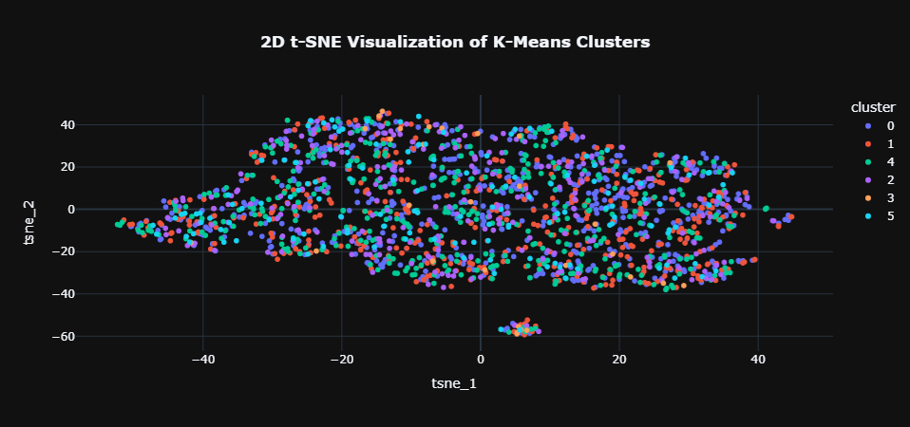
2.3 2D t-SNE Visualization of K-Means

Slide 12




2.4 Hybrid Recommendation Engine 05
We combined two distance-based methods to ensure recommendations are both broadly thematic and specifically accurate.
+
•
Calculates distance to Cluster Center.
•
Finds nearest neighbors in feature space.
•
Returns songs that represent the General Vibe.
•
Returns songs with Specific Similarity (e.g., similar Tempo & Key).
•
Best for: Playlist generation, Mood exploration.
•
Best for: "Song Radio", Direct lookalikes.

Slide 13
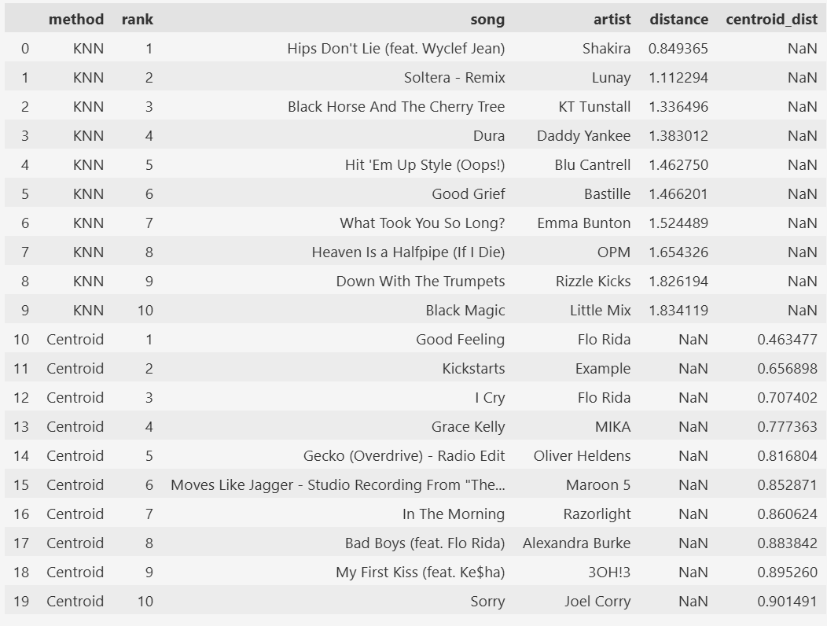


Live Demo: "Oops!... I Did It Again"
Recommendations
INPUT TRACK
Oops!... I Did It Again
Britney Spears
Cluster: High Energy Pop
Danceability: 0.75 | Energy: 0.83

